Slide 1
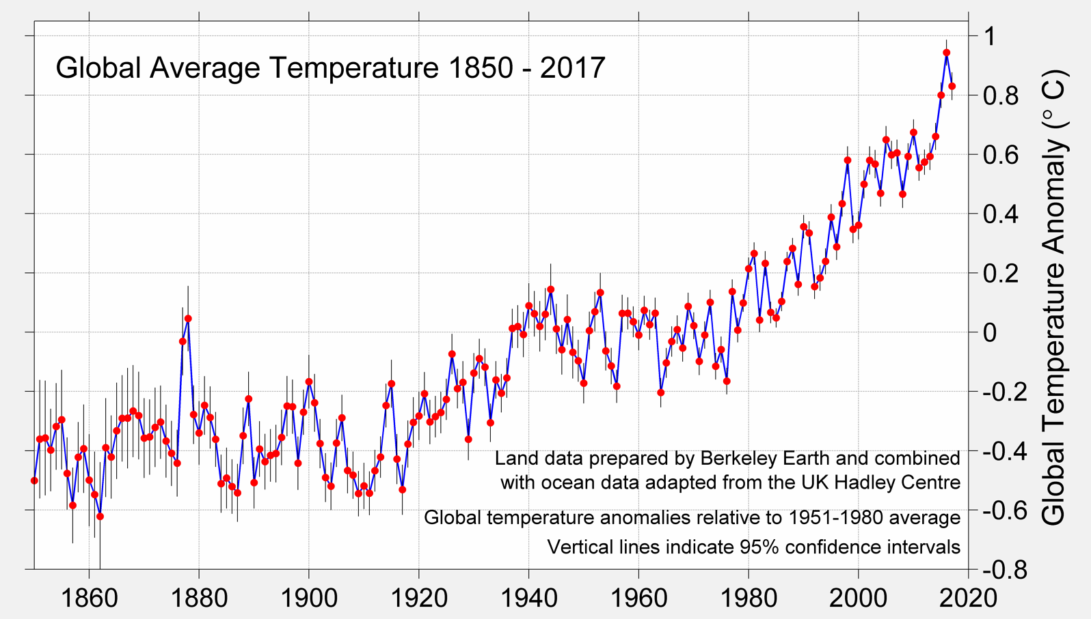
Berkeley Earth A Measured Approach: CLIMATE SCIENCE + STRATEGIC ANALYSIS
Berkeley Earth is independently operated, funded primarily by unrestricted educational grants.
We pursue objectivity without concern for policies of government, industry or philanthropic ventures.
This project was focused mainly on Temperature aspect of climate

Slide 2
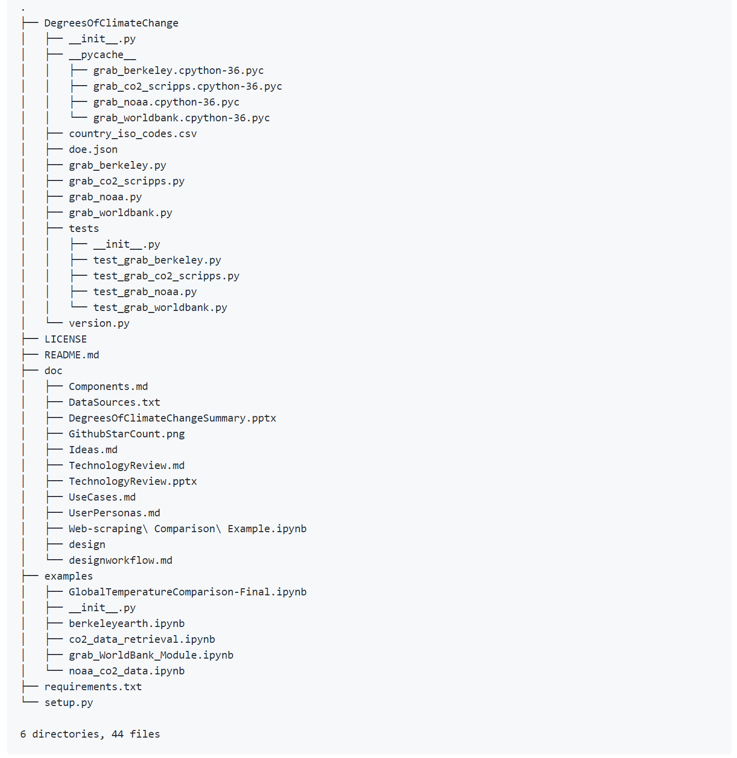
Project Structure

Slide 3
